Slide 1
2024
Data management Strategy 2024

Slide 2
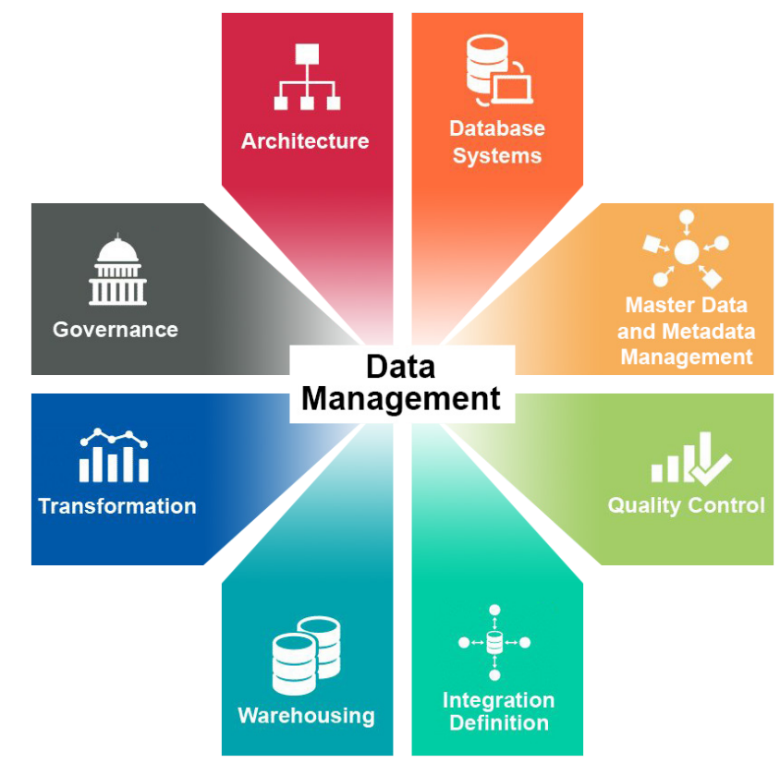
Executive Summary
The DMS goal is to help Sierra Space gain the best benefits from its data and data assets across all areas of data management.
The Data Management Strategy (DMS) is the process of creating strategies/plans for handling the data created, stored, managed and processed by an organization. Sierra Space’ DMS requires tight coupling with the IT Governance, Business Process Management & Project Management to create and implement a well-planned approach in managing our data assets. The primary objective in establishing the data management strategy is to develop a business strategy that ensures that data is:
Collected, stored, consumed and processed in a standard manner required by the Sierra Space and our partners.
Controlled, monitored, assured and protected using data governance and security.
Stored, categorized and standardized using defined and known data classification and quality framework.

Slide 3
Data Management Strategy Overview
Organizations make decisions about how they engage with, operate on and leverage their data - at an enterprise or project level. Organizations that form a holistic point of view in adopting an enterprise-grade data strategy are well positioned to optimize their technology investments and lower their costs. Such a strategy treats data as an asset from which valuable insights can be derived. These insights can be used to gain a competitive advantage by being integrated into business operations.
Sierra Space aims for a smooth transition to becoming data driven — aligning operational decisions to the systematic (and automatic as much as possible) interpretation of data needs a plan for advancing its digital transformation journey and treating data as an asset. Implementing a data management strategy (DMS) is the first step toward enabling such a plan and increasing Sierra Space’ AI and Analytics IQ.
A DMS ensures that all data initiatives follow a common method and structure that is repeatable. This uniformity enables efficient communication throughout the enterprise for rationalizing and defining all solution designs that leverage data in some manner. Creating a data strategy is both achievable and valuable. It’s also an essential component of Sierra Space’ digital transformation journey
Notes:
STEVE: From my perspective, the highlighted part is super critical, and currently “the cart is before the horse”.
For example, favoring the broad implementation of Artificial Intelligence, before identifying the foundational / fundamental *human* controls that are necessary to effectively manage the usage of AI and its associated concepts (Machine Learning, Large-Scale-Automation, etc.) is bound to spiral out of control due to the very nature of those concepts.
Governance in general is a practice that promotes an understanding of the value and importance of a measured, controlled approach to these technologies, and where human interaction is required.

Slide 4
Data Management Strategy Drivers
Common drivers for an effective DMS:
Unification of all departments and IT perspectives. A common data strategy ensures that all departments and IT are positioned as joint leaders of the company’s direction by understanding each other’s needs, capabilities and priorities.
Enterprise-wide alignment of vision and guidance on leveraging data as an asset. Such alignment, captured in a data strategy, ensures that different groups in the enterprise view data-related capabilities with consistency, which reduces redundancy and confusion.
Definition of key metrics and success criteria across the enterprise. The data strategy defines “success” and “quality,” thus reinforcing consistency for how initiatives are measured, evaluated and tracked across all levels of interacting organizations
Notes:
STEVE: This is great.
I’d stress the collaborative part of the first bullet, while positioning us as the “thought leaders” for the overall effort.
The second bullet is where I think we should explicitly call out how we require sponsorship from senior leaders.
The third bullet is where I think we should state that this is where “data owners” are going to have to contribute.

Slide 5
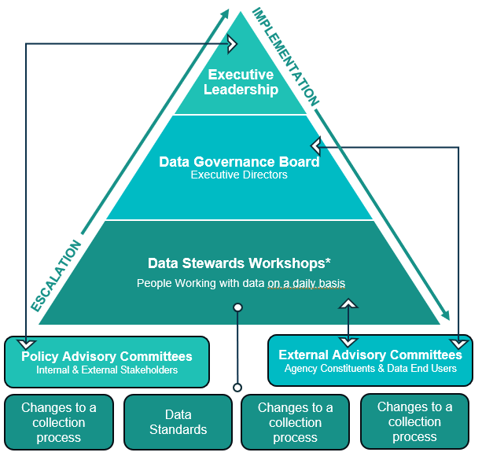
Data Governance Structure
From the execution side, an established Data governance touches every part of the data management process down to the individual technologies, databases and data models. The governance process also affects the processes people use to create and retain data and how these rules are replicated within applications to help make smarter decisions faster.
The effective part about a data governance is that we do not have to start from scratch (there are pockets of data governance already happening), and new efforts can tap into those to find leaders, supporters and advocates.
Figure 1 is the high-level layout of the data governance committee structure. Escalation flows up the pyramid with the executive leadership having decision-making authority, and implementation flows down the pyramid with the data stewards being the subject matter experts and best suited to implement processes and changes to data.
This structure allows us to clearly identify decision-making authority at all levels.
Figure 1
Notes:
STEVE: The previous slide segues really nicely into this one.
Here, I’d stress the part that even though this seems like a “new” set of responsibilities for everyone, we’re actually taking advantage of groundwork that’s already been laid as often as we can.
In terms of the Data Governance Board, I think we should try to hammer in the idea that this is cross-functional to a large extent, what do you think?

Slide 6
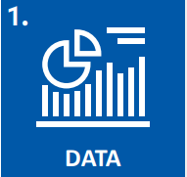
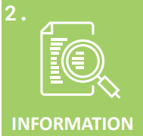
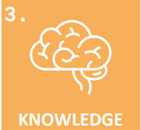
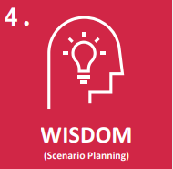
Why do Data Management?
Data Management helps with a tighter information control that builds opportunities and reduces risks of data breaches, privacy violation, distributing bad data.
Information quality - Having enterprise-wide data standards, definitions and coordinated effort will improve data quality.
Ability to integrate - Well-defined data management processes allow an organization to be proactive and integrate with organizational changes or developments at a reduced cost and with limited burden.
Performance management and business intelligence - Defining clear ownership of data, controlling data quality and implementing data management will reduce the costs and complexity of performance management and business intelligence.
Establish new rules and processes - Creating and implementing standard, formalized rules and processes is key to ensuring data are trusted, secure and ultimately fit for business usage.
Align or modify the existing rules and processes - Assessing existing rules and processes to ensure they are accomplishing the purpose intended and modifying them if needed.
Richer data environment and regulatory compliance - Overall, data governance leads to a richer data environment and ensures regulatory compliance.
INFORM
“What happened?”
EXPLORE
“Why did it happen?”
PREDICTIVE
“What will happen next?”
PRESCRIPTIVE
“What’s the best we can do?”
Notes:
STEVE: Examples for Inform / Explore / Predictive / Prescriptive:
Alert Automation
Incident Investigation
Machine Learning / AI
Direction and suggestions based upon our thought leadership.

Slide 7
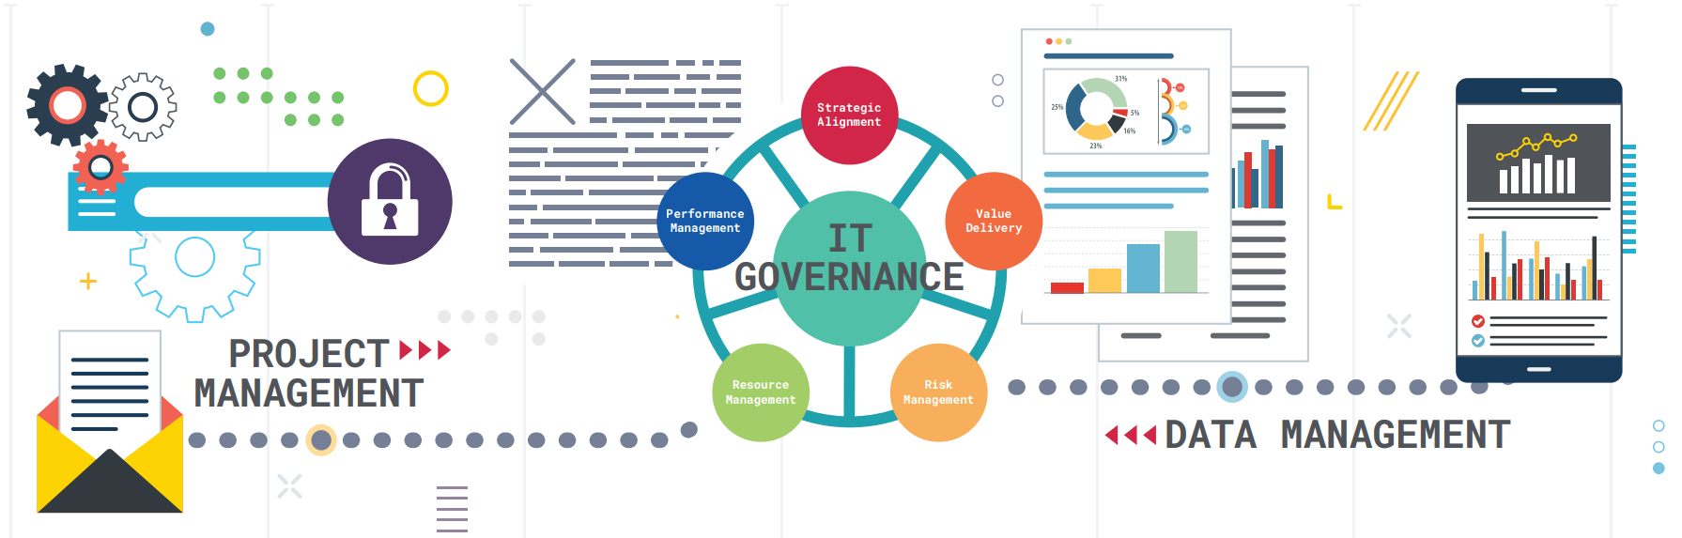
Data Management and IT Governance
Data Management complements Project Management. Both exist under the overarching structure of IT governance.
Project Management focuses on defining a portfolio of investments, setting performance objectives, and evaluating and managing risk for IT projects.
Business Process Management facilitates the alignment of business specifications with the data the process needs. A shared model (not siloed) can help to keep the process and its data synchronized and reusable across the organization.
Data Management focuses on creating a structure enabling an organization to align data efforts to business objectives, to support regulatory compliance and to manage risks associated with data.
IT governance is the overarching structure that focuses on IT infrastructure, including managing resources and risks, to ensure IT efforts and solutions align with our mission and business goals. IT governance focuses on the pipelines in the organization’s IT infrastructure, data and project management focus on the water that flows through those pipelines while business process management defines how the water will flow.
BUSINESS PROCESS MANAGEMENT
Notes:
A business process model facilitates the alignment of business specifications with the data the process needs. A shared model (not siloed) can help to keep the process and its data synchronized and reusable across the organization.

Slide 8
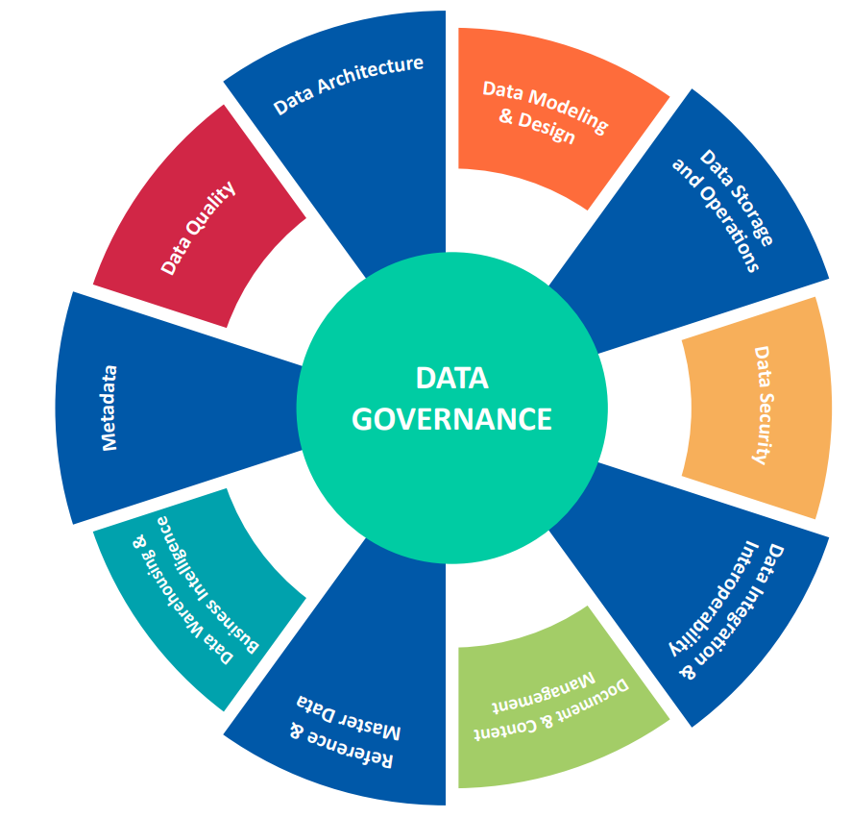
Data Governance Framework
Managing the dynamic, ever-growing landscape of data technology and our fluctuating operations requires clear and consistent communication and guidance. A data Management strategy must account for how an organization plans to mature its datacentric capabilities and enable new data- and analytics-based products and services to mature.
For the successful execution of such a roadmap, adoption of industry standards is very crucial. We have adopted the Data Management Association (DAMA) Framework for effective data governance. DAMA is the global body for data management and lays out frameworks and standards that adopt to the changing landscape of technology.
A data governance centric framework allows us to “decide how to decide” and helps to define overarching rules by coordinating, weighing and balancing the needs of all stakeholders through identifying:
A decision-making process
Roles and responsibilities of department
Rules and processes consistent across the enterprise
It also outlines how to make decisions about managing data, realizing value from it, minimizing cost and complexity, managing risk and ensuring compliance. In short, data governance sets the rules of engagement for data management activities, and the framework is the workflow for those rules of engagement
Notes:
Data Gov is a practice not a project.

Slide 9
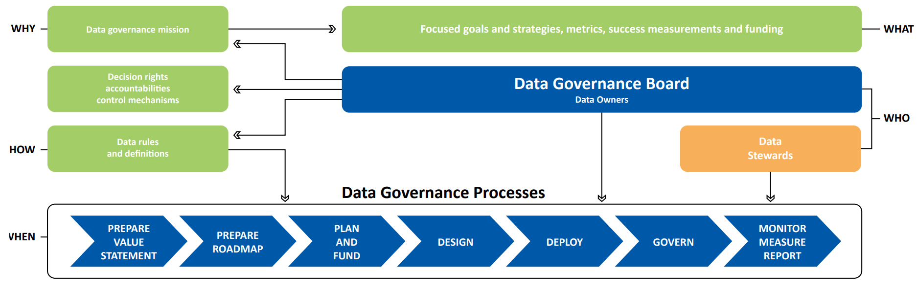
Data Management Strategy
Data governance enables us to focus on data centric architecture, and the interoperability of data will improve our capability to make data driven decisions.
WHY your specific program should exist
WHAT it will be accomplishing
WHO will be involved in your efforts, along with their specific accountabilities
HOW data governance processes will be achieved
WHEN specific data governance processes will be performed

Slide 10
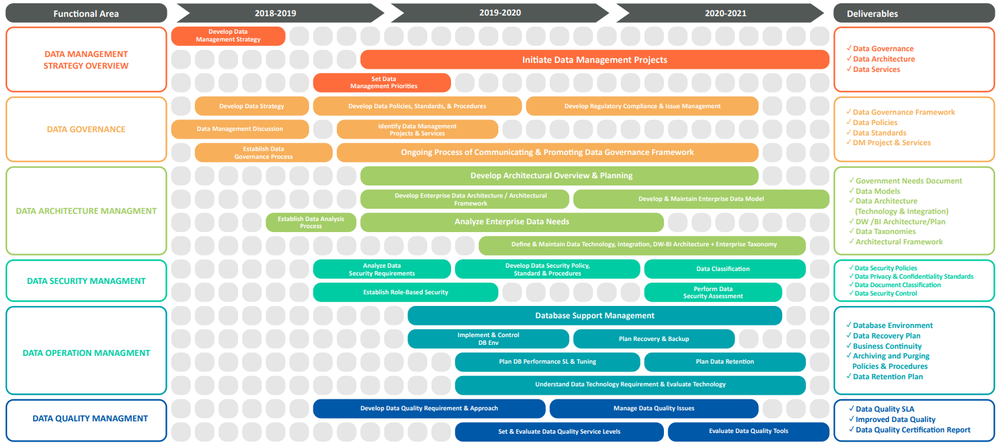
The high-level Data Management plan (DMP) details the various functional areas, timeline and intended deliverable at each stage of the execution of the DMS. The deliverables in each functional area will describe the data we expect to acquire or generate during the course of the effort, how we will manage, describe, analyze, and store those data, and what mechanisms we will use at the end to share and preserve our data.
Executive Road Map
2024
2025-2026
2026-2027

Slide 11
Questions

